Slide 1
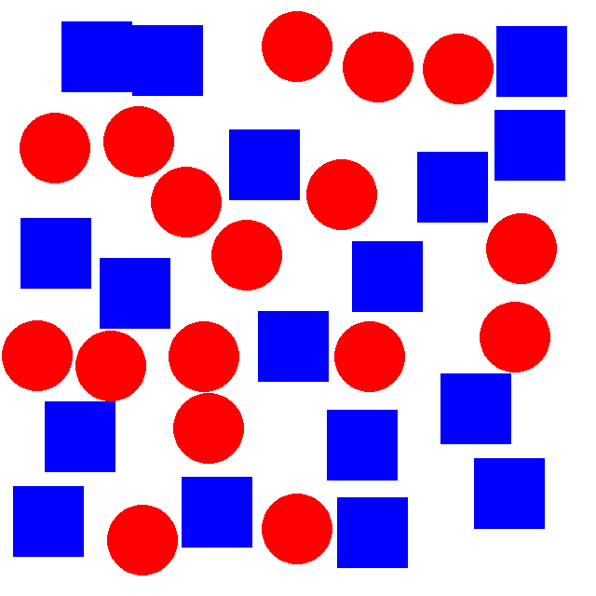
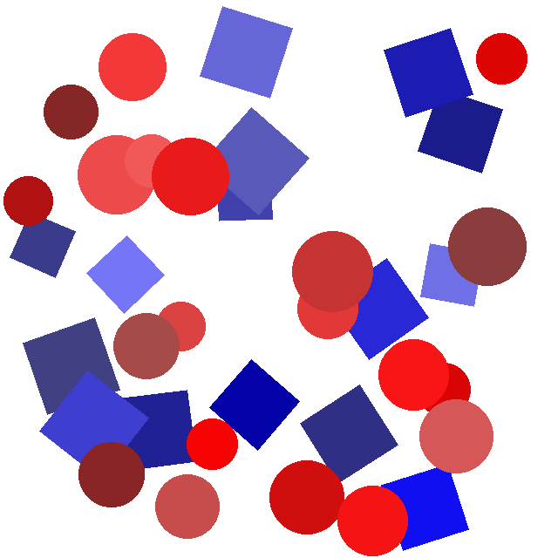
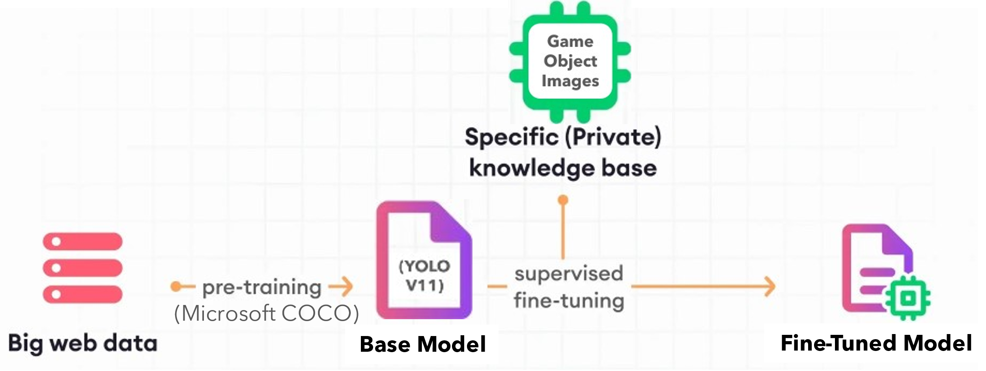
MEEG 4910V – ML for MEs
Project: Kick-Off Presentation
By: Kaushik Ramini
Project Title: Object classification and quantification program
Dataset Creation: Image Generator
Simple Dataset
Complex Dataset
Model Building:
Fine Tuning Method
Data
Augmentation
Training Dataset
Dataset in YOLO format: Image + Label File
Testing Dataset
Notes:
Intro: Want to use this as starting pt for computer vision using 3D objects in a game engine. (images from game engine vs. python, process is same).
Methodology
Fine tuning: model is 319 layers and 2.6 million parameters

Slide 2
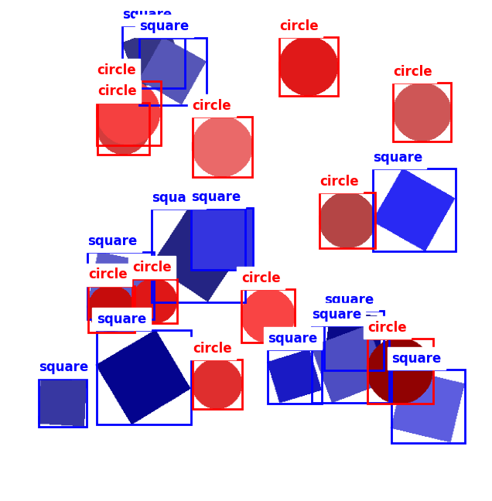
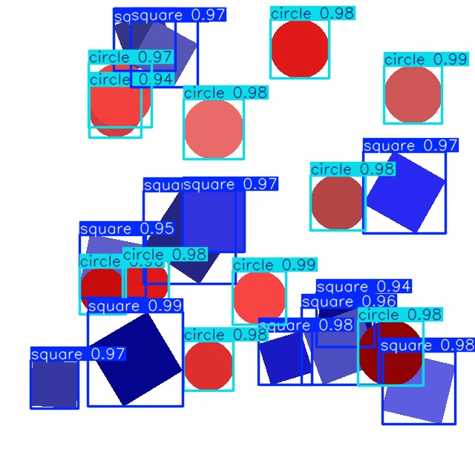
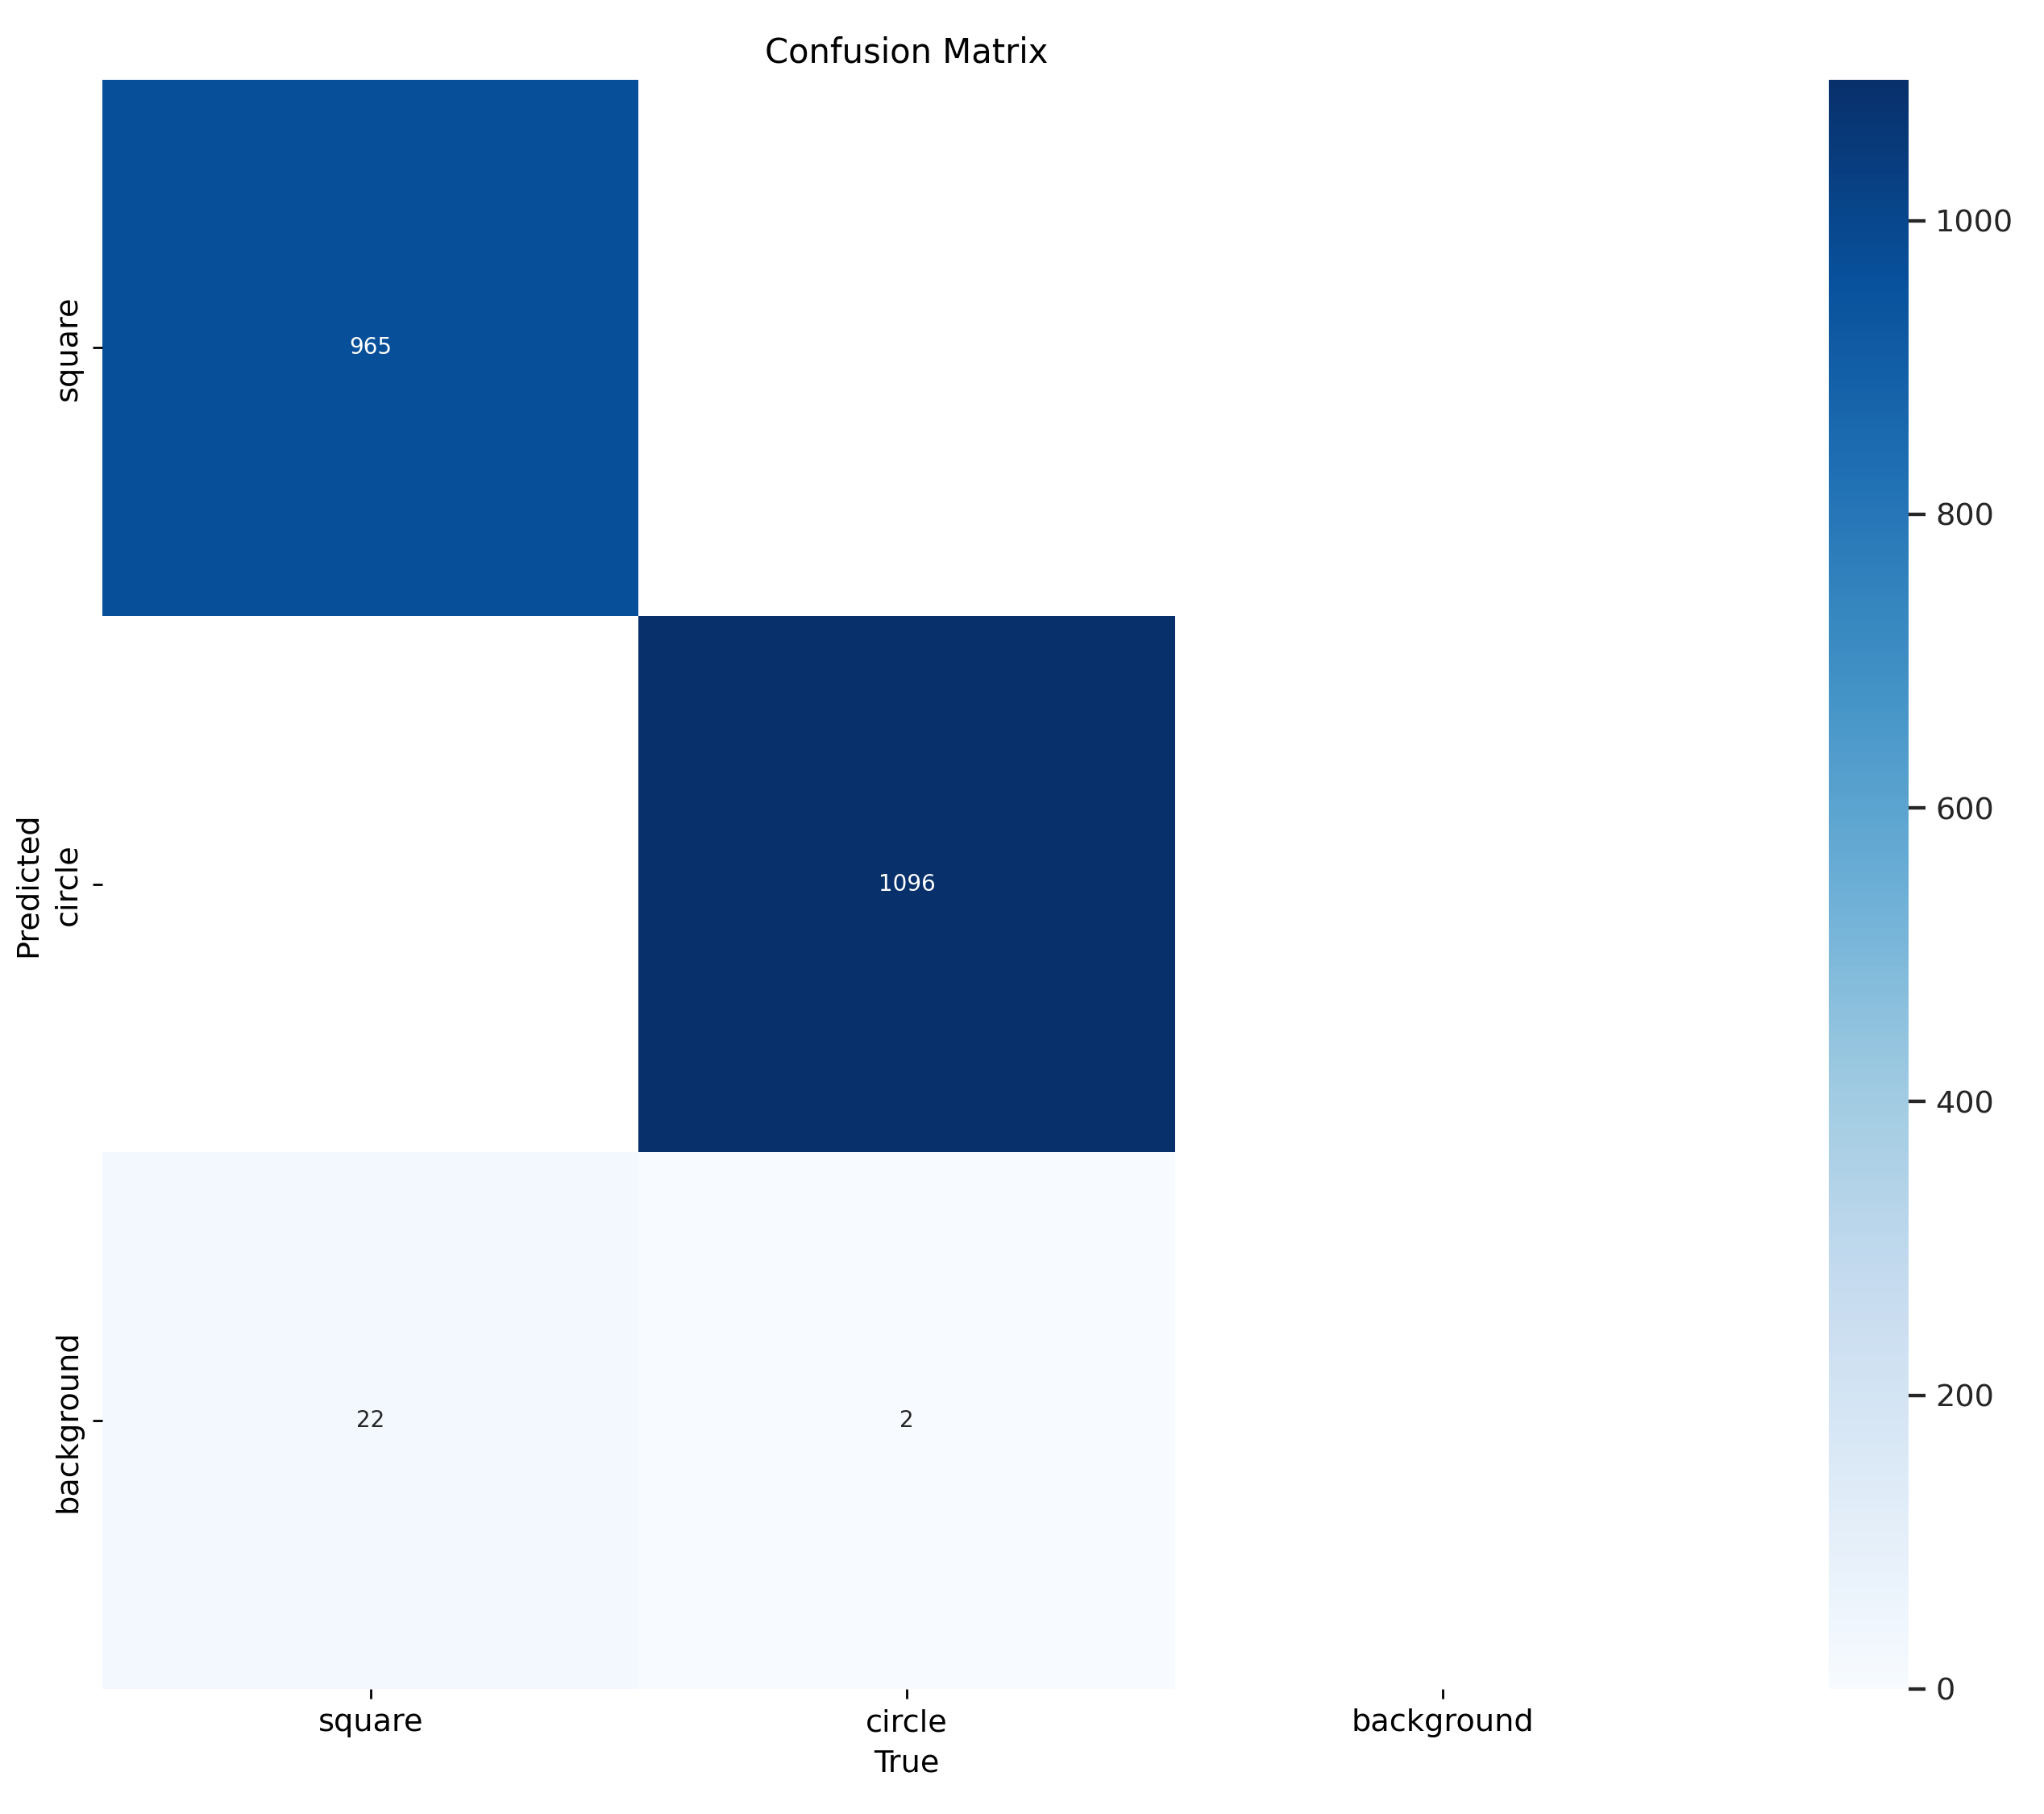
Results
Test Image + Label
Predicted Image + Label
Cumulative Results
97.2% accuracy across 100 images (2085 instances)
Consistent performance irrespective of shape size, color shade, and orientation. Performance degrades past 60% overlap.
Of the 24 errors, 22 are missed object detections
~10.5ms prediction time per image, 3x faster than 30FPS video
Notes:
Results + Significance
Displaying image_110_squares_12_circles_11.png: (up to 60% overlap) – Pred in 10.2ms, 100% accuracy in sample image. No time difference for an image w/ 3 shapes or 30 shapes.
For 30FPS video, each frame is 33ms long. That means the model could interpret in real time, it predicts 3x faster than the video framerate.

